Slide 1
High Performance, Secure, Reliable Systems
Sam Ainsworth, Lecturer in Systems and Hardware Security, University of Edinburgh

Slide 2
High Performance

Slide 3
Graph and Programmable Prefetchers (ICS 2016, ASPLOS 2018)
0
7
Work List
5
4
1
2
3
7
Vertex List
0
2
3
5
7
10
11
12
12
Edge List
1
2
7
0
6
0
1
1
2
3
4
2
Visited
False
True
True
True
True
True
False
True
1
2
3
4
6
5

Slide 4
Graph and Programmable Prefetchers (ICS 2016, ASPLOS 2018)
Snoops &
Prefetched Data
From L1 Cache
Address
Filter
Event
Queue
Programmable Units
CPU
CPU
CPU
CPU
CPU
CPU
Prefetch Request Queue
To DTLB
& L1 Cache

Slide 5
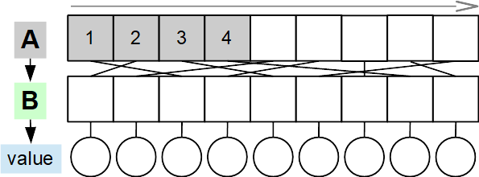
Vector Runahead (ISCA 2021)

Slide 6
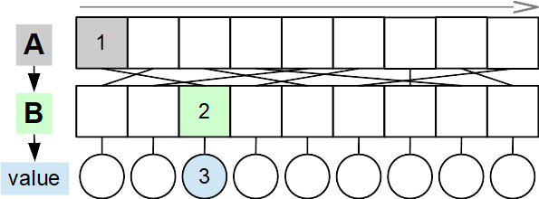
Vector Runahead (ISCA 2021)

Slide 7
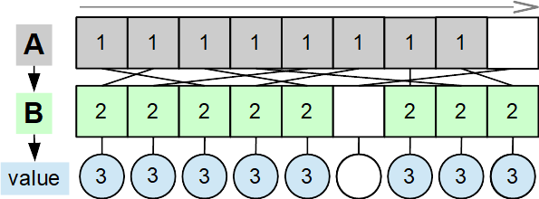
Vector Runahead (ISCA 2021)

Slide 8
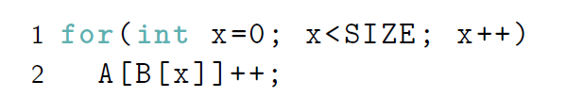
Gather-Level Parallelism

Slide 9
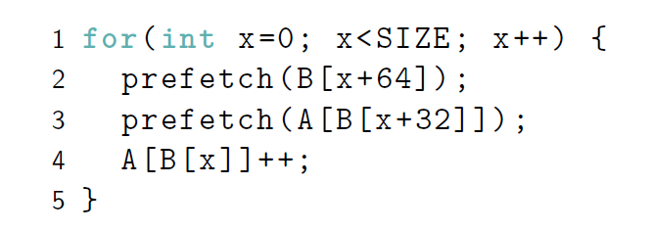
Gather-Level Parallelism

Slide 10
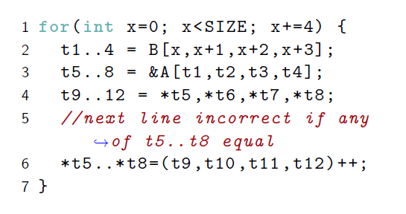
Gather-Level Parallelism

Slide 11
Gather-Level Parallelism

Slide 12
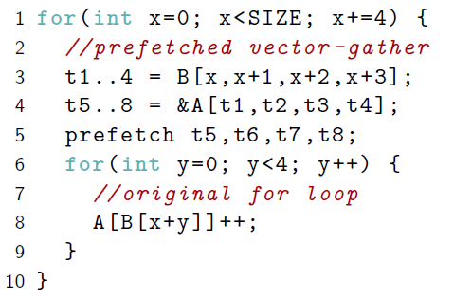
Gather-Level Parallelism

Slide 13
Reliable

Slide 14
ParaMedic (DSN 2018, DSN 2019, HPCA 2021)
Main Core
Time
...
add
multiply
divide
jump
…
...
…
…
…
...
…
…
…
...

Slide 15
ParaMedic (DSN 2018, DSN 2019, HPCA 2021)

Slide 16
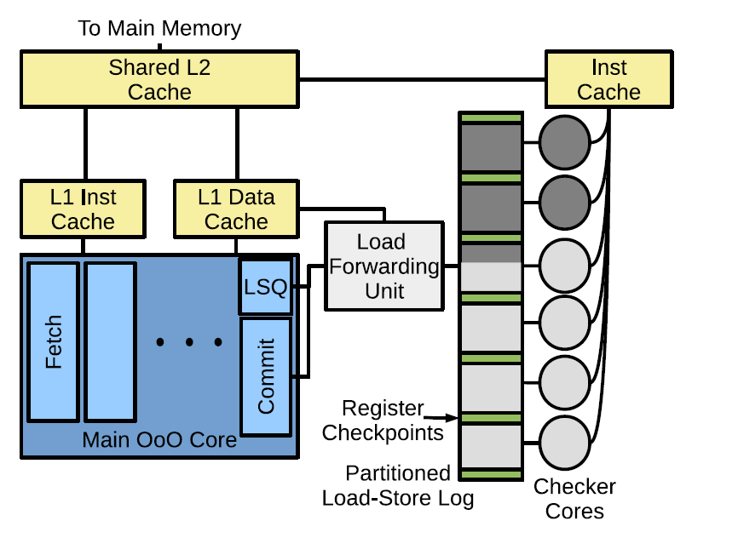
ParaMedic (DSN 2018, DSN 2019, HPCA 2021)

Slide 17
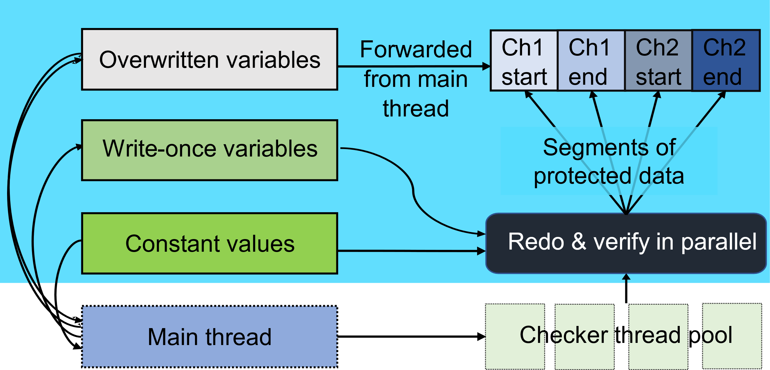
ParaDox: Heterogeneous Error Detection in Software!

Slide 18
Secure

Slide 19
Use-After-Free Attacks

Slide 20
Use-After-Free Attacks

Slide 21
Use-After-Free Attacks

Slide 22
MarkUs (S&P 2020) Quarantine List
free(A)
Heap
A
A
¼ of the Heap

Slide 23
MarkUs Marking Procedure
Stack
BSS
Data
Regs
Heap
C
G
J
A
H
B
E
K
D
F
I
Quarantine List
A | B | C | D | E | F | G | H | I | J | K
0 | 1 | 1 | 1 | 1 | 0 | 1 | 0 | 1 | 1 | 1
Mark List

Slide 24
MineSweeper Sweeping Procedure
Stack
BSS
Data
Regs
Heap
C
G
J
A
H
B
E
K
D
F
I
Quarantine List
A | B | C | D | E | F | G | H | I | J | K
0 | 1 | 1 | 1 | 1 | 0 | 1 | 0 | 1 | 1 | 1
Mark List

Slide 25
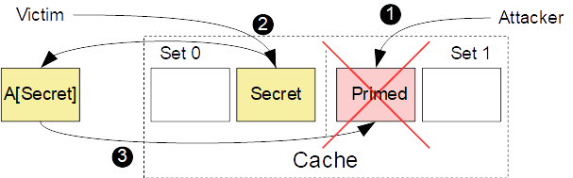
Spectre

Slide 26
MuonTrap (ISCA 2020)
Hide speculative state in filter caches, and clear on
context switch (optionally on all misspeculation)

Slide 27
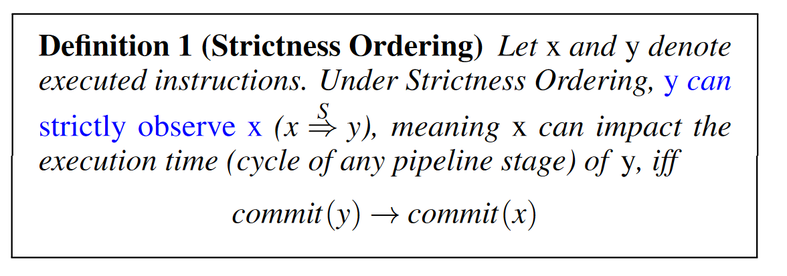
Strictness Order (MICRO 2021)

Slide 28
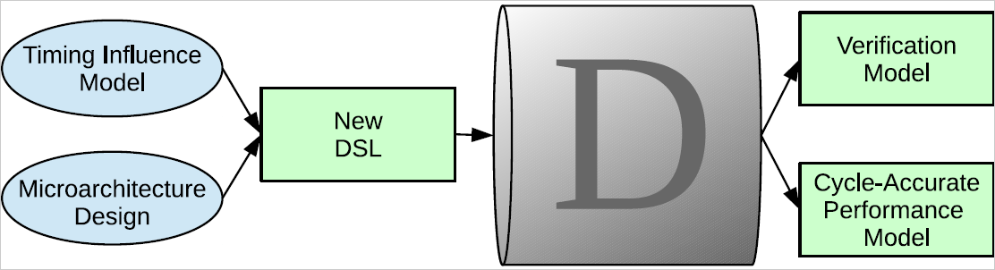
Dijkstra’s Pipe

Slide 29

“The real Spectre”

Slide 30
How can Arm help?

