Slide 1
NetSentry: A Deep Learning Approach to Detecting Incipient Large-scale Network Attacks
Haoyu Liu

Slide 2
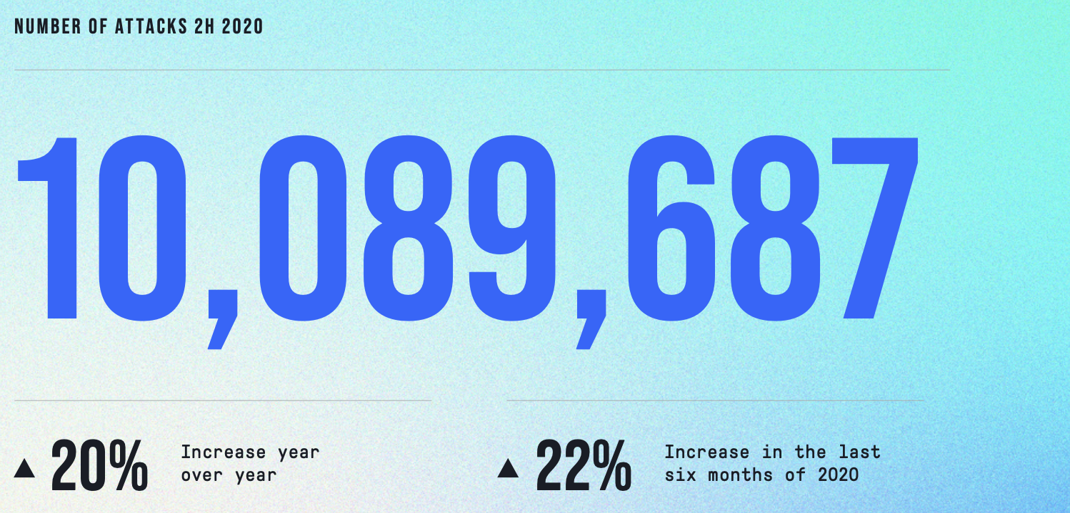
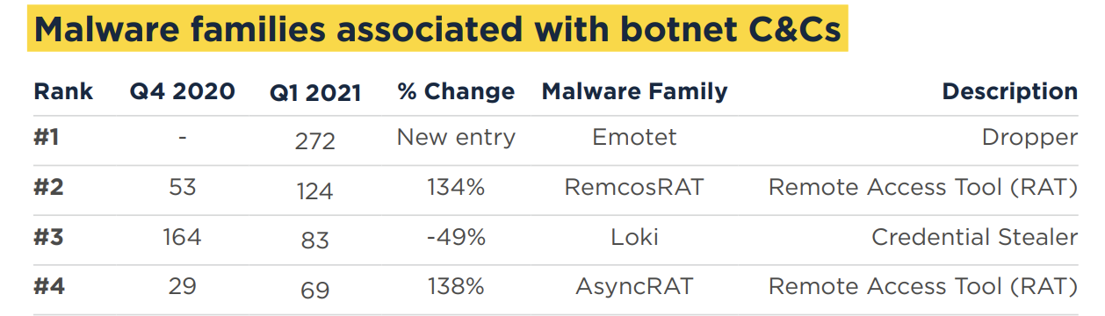
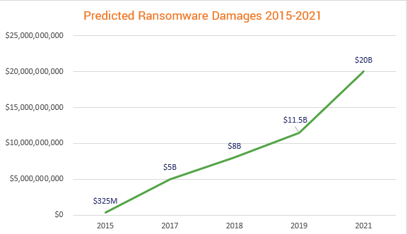
High-profile network attacks
DoS/DDoS
Botnet C&C server
Ransomware cost

Slide 3
Existing Countermeasures
Rule-based network-based Intrusion Detection Systems (NIDS)
  Prone to circumvention [1]
  Heavily rely on expert experience
Existing ML/DL-based NIDS
  Learn the statistical patterns
  Vague threat modelling and methodology
  Lack of comprehensive evaluations
[1] L. Bilge and T. Dumitras ̧, “Before we knew it: An empirical study of zero-day attacks in the real world,” inProceedings of the 2012 ACM Conference on Computer and Communications Security, p. 833–844.

Slide 4
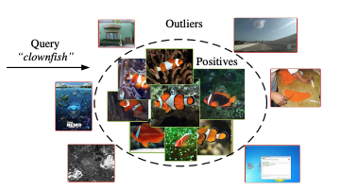
  Vague threat modelling and methodology
Semi-supervised methods:
Assumption: The statisical patterns of the benign deviate from the malicious
Reconstruction-based
  Yisroel Mirsky, Tomer Doitshman, Yuval Elovici, and Asaf Shabtai, "Kitsune: An Ensemble of Autoencoders for Online Network Intrusion Detection", Network and Distributed System Security Symposium 2018 (NDSS'18)
Statistical-based
  Zong, Bo, Qi Song, Martin Renqiang Min, Wei Cheng, Cristian Lumezanu, Daeki Cho, and Haifeng Chen. "Deep autoencoding gaussian mixture model for unsupervised anomaly detection." In International Conference on Learning Representations. 2018.
Neural-net-based
  Ruff, L., Vandermeulen, R., Goernitz, N., Deecke, L., Siddiqui, S.A., Binder, A., Müller, E. & Kloft, M.. (2018). Deep One-Class Classification. Proceedings of the 35th International Conference on Machine Learning, in PMLR 80:4393-4402
Benign Traffic:
Downloading, gaming, browsing,
Streaming, bittorrent…

Slide 5
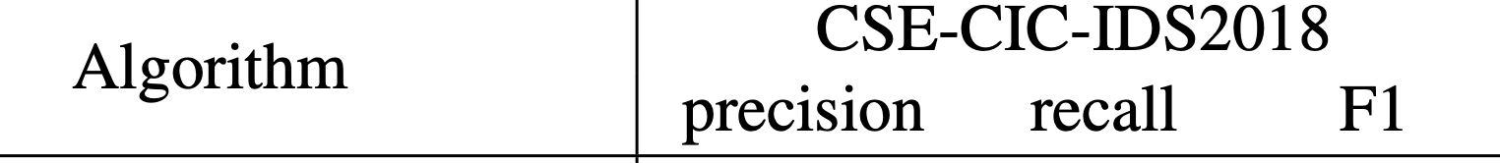
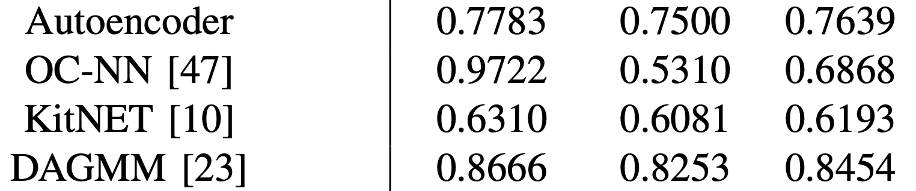
Performance on an up-to-date cyber security dataset
reconstruction
Neural-net
Statistical

Slide 6
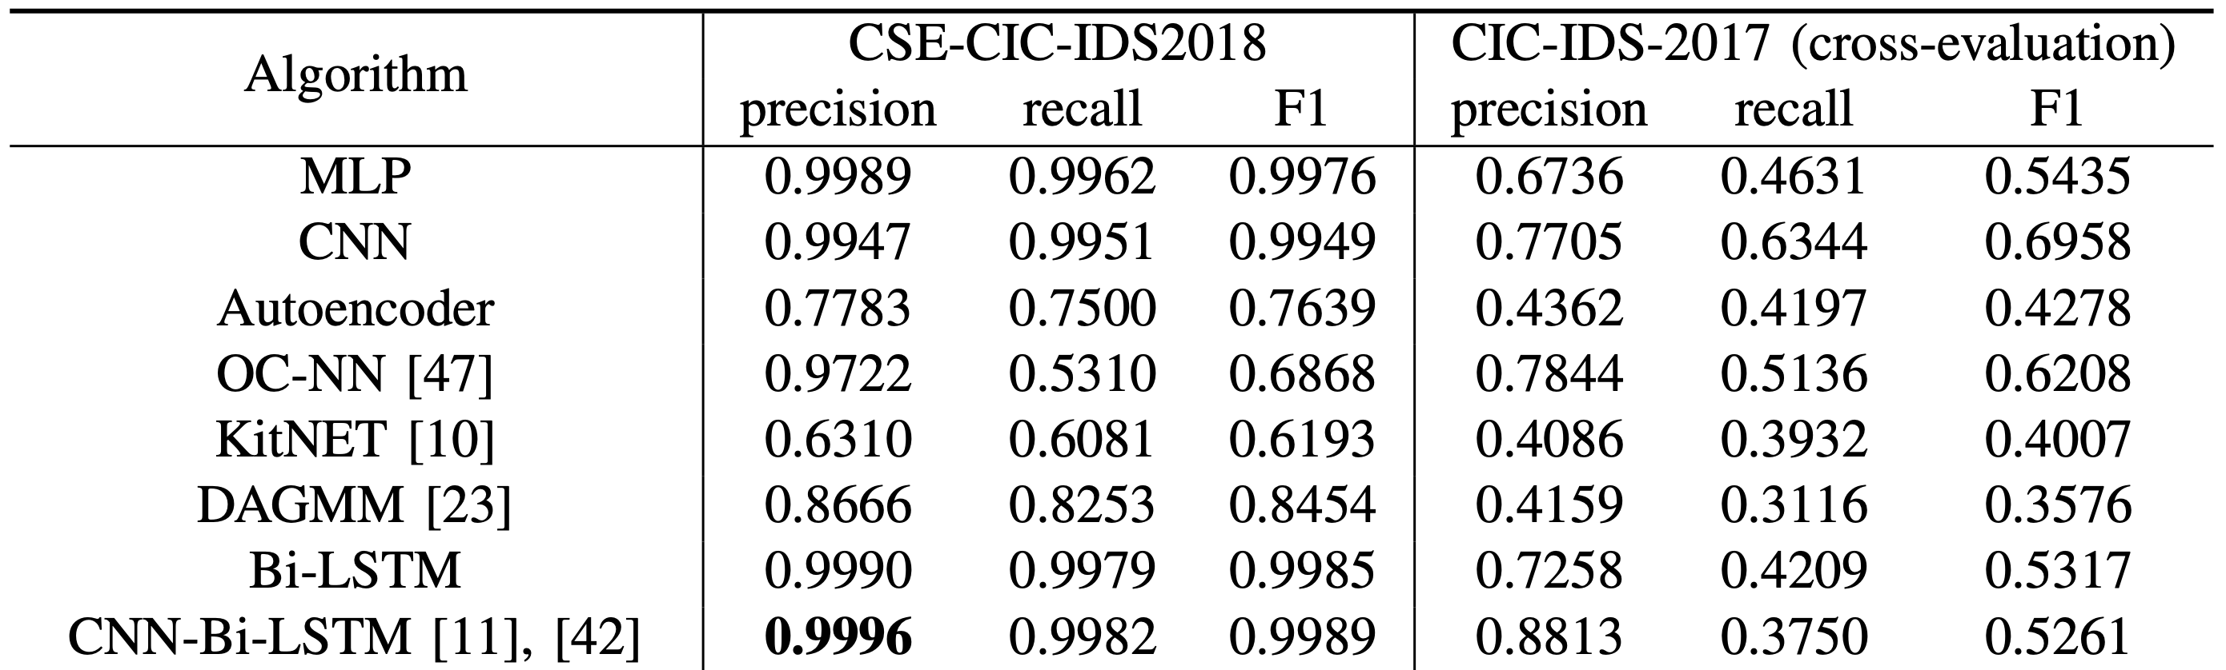
Lack of comprehensive evaluations
ML/DL Evaluation Routine:
  Train-test split one dataset
… but the issue is:
Can one dataset fully represent the heterogeneity of the network traffic?
Cross Evaluation: test on a second, unseen dataset

Slide 7
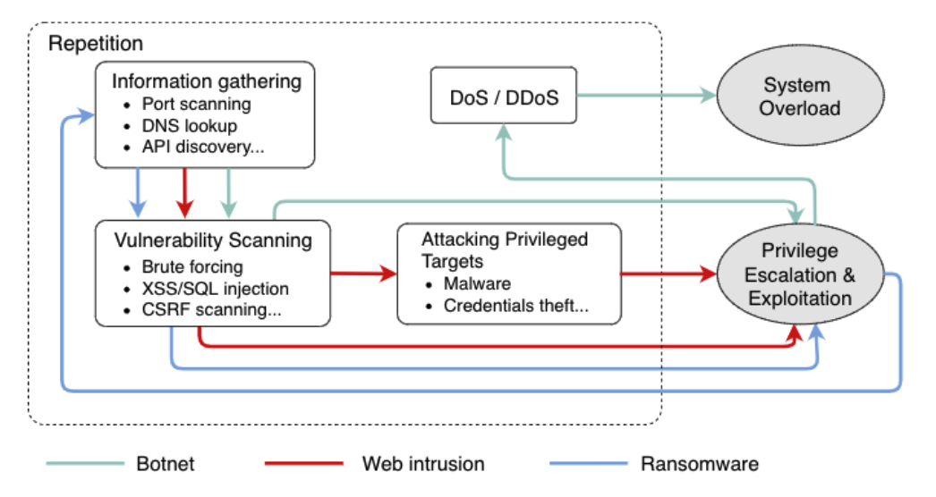
F-secure: 99% captured attacks were generated by bots, malware and automated tools [2].
Attack Chains
[2] F-Secure. Attack Landscape H1 2019. https://blog-assets.f-secure.com/wp-content/uploads/2019/09/12093807/2019_attack_landscape_report.pdf , 2019

Slide 8
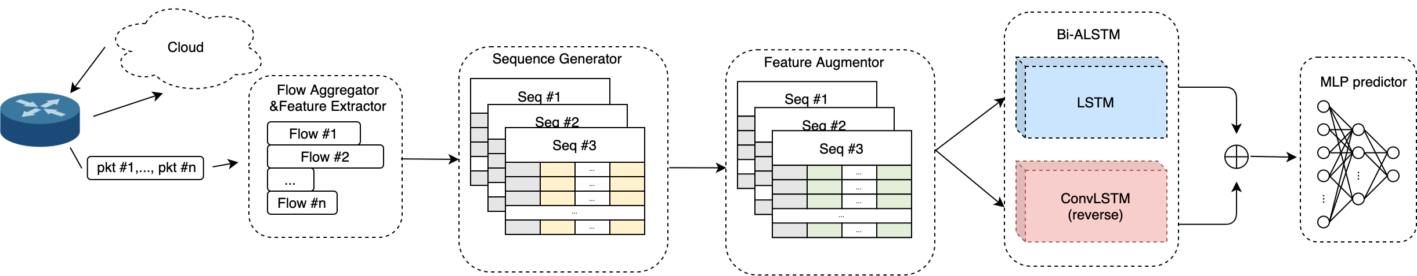
Defending solution: NetSentry
Flow : TCP/ UDP connection
aggregated by
(src ip, dst ip, src port, dst port, protocol)
Feature Extractor: CICFlowMeter (CIC-IDS-2017/2018)
Sequence: Consecutive flows generated by a pair of hosts in a given time interval.
aggregated by: (src ip, dst ip, protocol)

Slide 9
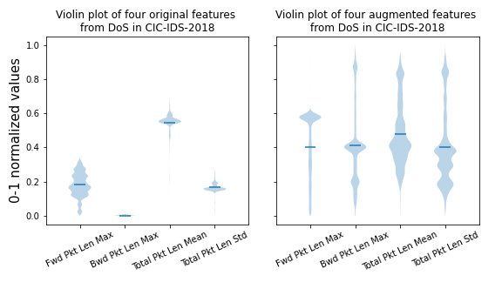
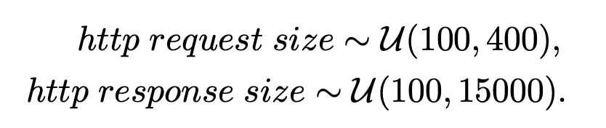
Data Augmentor
Environment Setup:

Slide 10
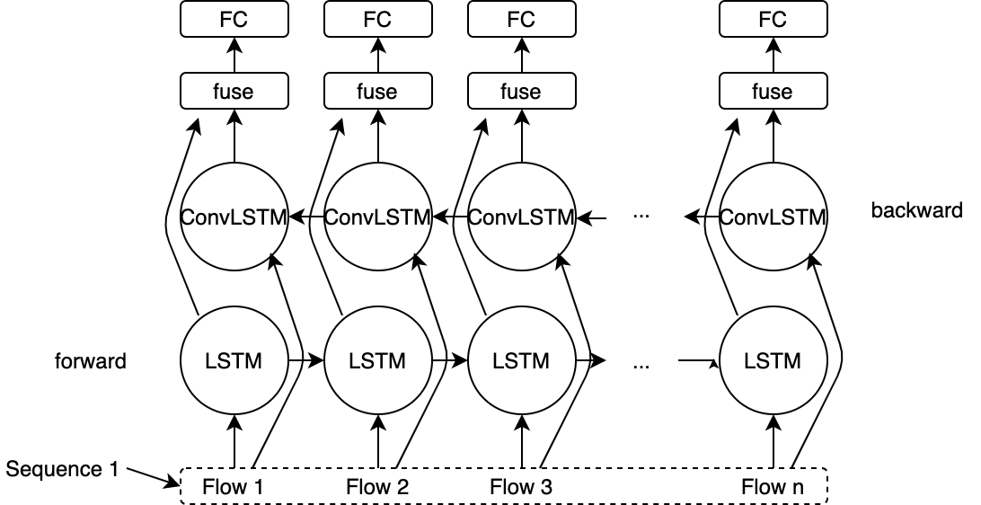
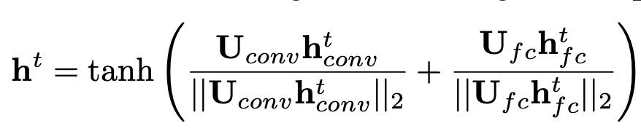
Bidirectional Asymmetric LSTM (Bi-ALSTM)
Fusion:
Where

Slide 11
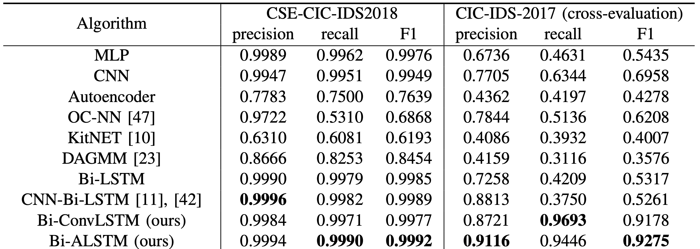
Evaluations – Bi-ALSTM (without data augmentation)

Slide 12
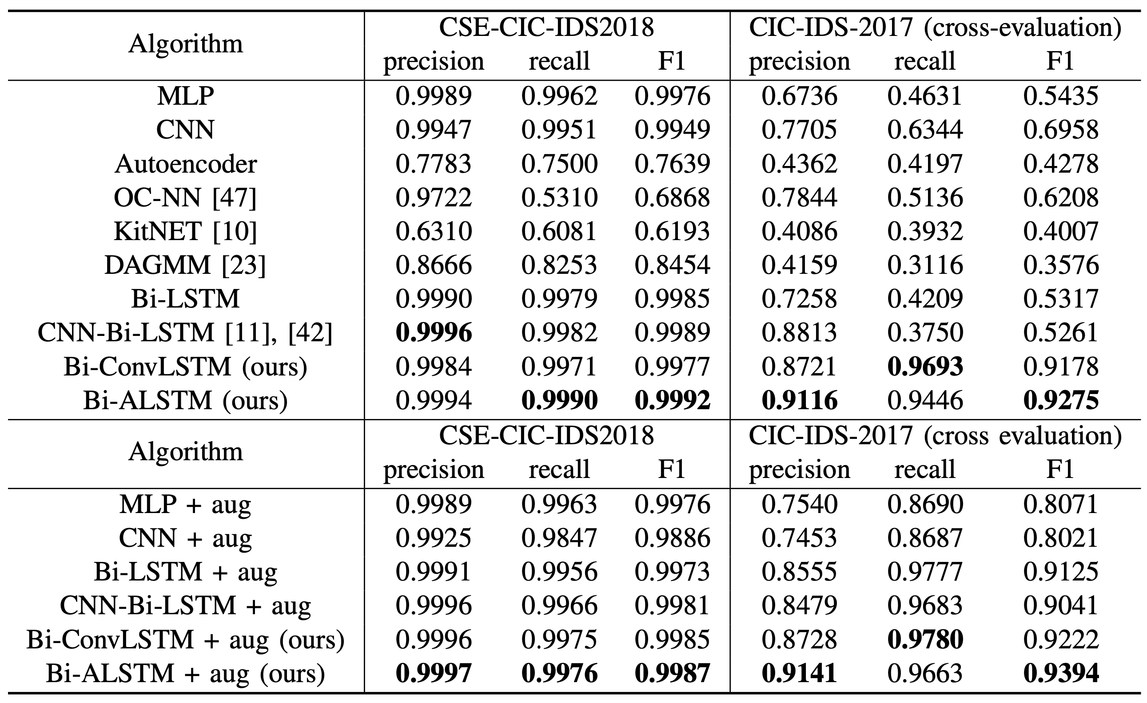
Evaluations – Data Augmentation

Slide 13
The Distinguishability of TLS Tunnel

Slide 14
Background – TLS tunneling
Cloud
Censored Client
Applications
Chrome
Mail
Proxy server
Proxy client
Inbound Proxy
Outbound Proxy
Inbound Proxy
Outbound Proxy
SOCKS
TLS Tunnel
HTTP
TCP
HTTP

Slide 15
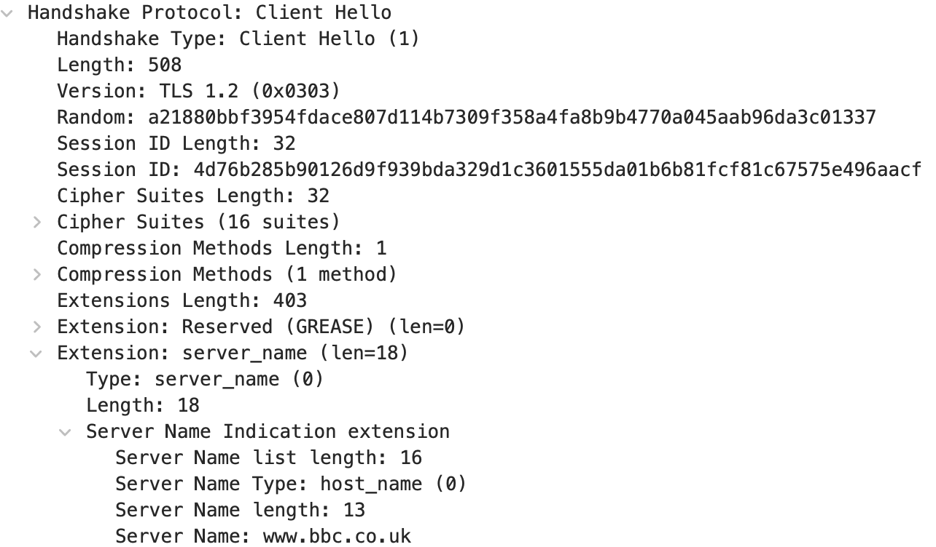
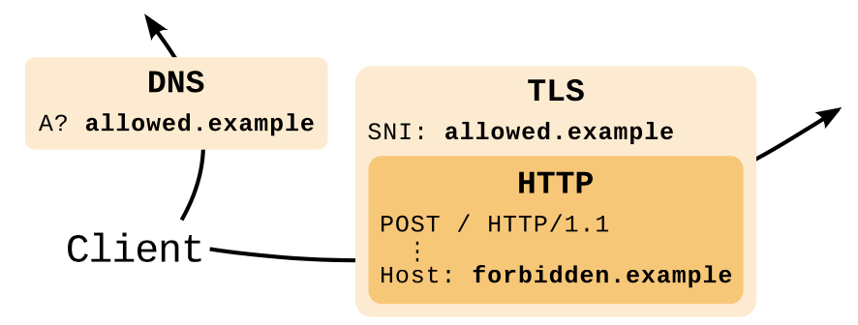
Background – TLS tunneling
Fingerprints in TLS handshake [1]
Domain Fronting [2]
[1]. Frolov, Sergey, and Eric Wustrow. "The use of TLS in Censorship Circumvention." NDSS. 2019.
[2]. Fifield, David, et al. "Blocking-resistant communication through domain fronting." Proc. Priv. Enhancing Technol(PETS). 2015.2 (2015): 46-64.

Slide 16
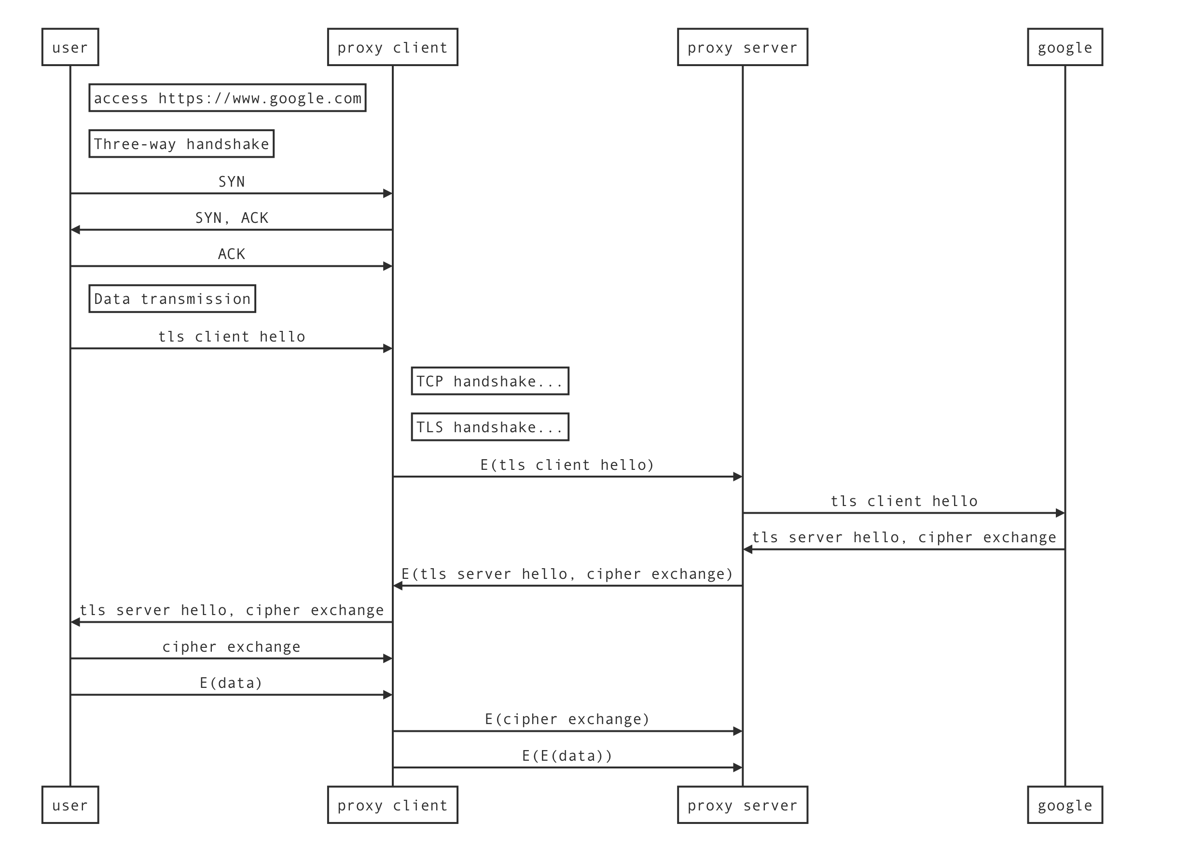
Statistical Differences between TLS tunnel and HTTPS

